Slide 1
Newsy
News Summarizer
Assignment 8 Team 4 AIAP7
25/01/2021
https://text-summariser-newsy.herokuapp.com/

Slide 2

Team 4 Team Members
Mentor: Kenneth Wang
Rui Han Lim
Anthony Khoo
Pei Wen Choong
Daniel Wong

Slide 3
Contents
1. Our Project
2. Datasets
3. Data Preprocessing
4. Modelling
5. Evaluation
6. Deployment
7. Demo

Slide 4
Our Project

Slide 5

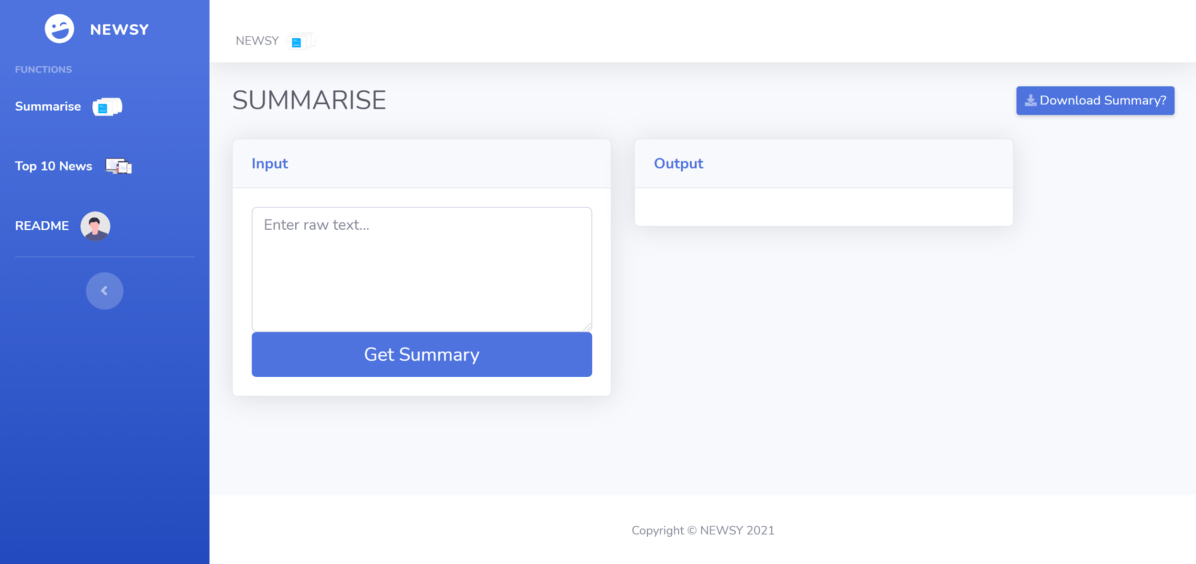
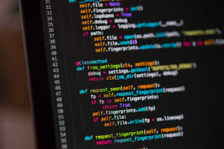
News Article Summarization
BBC News Dataset
News articles
Summaries
Modelling
A simple summarizer that can take in news articles and output its summary

Slide 6
2. Dataset

Slide 7
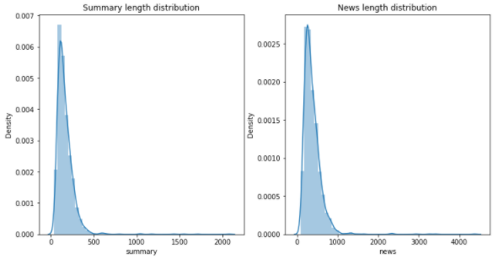
Dataset
Contains news articles from the BBC News from 2004 to 2005
Created using a dataset used for data categorization that consists of 2225 documents (each document has its own news article + summary)
5 categories
- Sport (511 documents)
- Business (510 documents)
- Politics (417 documents)
- Technology (401 documents)
- Entertainment (336 documents)
Length of the summary given in the dataset are mostly below 500 words
Length news article are mostly below 1000 words

Slide 8
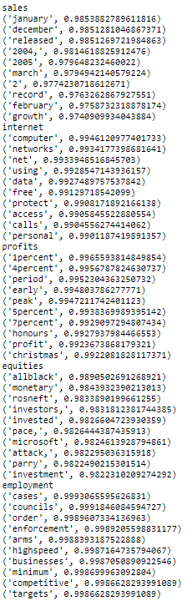
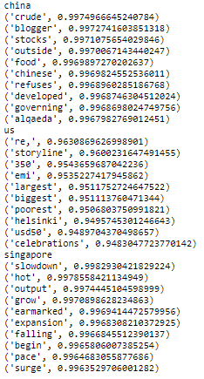
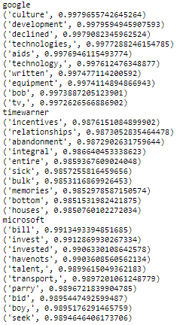
Word2Vec - similar word
Common Words
Country
Companies
Notes:
For the common words that are found in news articles, the similar words generated seemed to be words that are commonly found with them. As for countries’ names, we found that the similar words generated are more dependent on the news related to the country at that point of time. (e.g. for us, the word helsinki is for the declaration of helsinki in 2004, crude was related to China as oil demand was surging in 2004, for Singapore, there was a slowdown in economy due to SARS then a surge later on...), same thing was observed for company-related words.

Slide 9
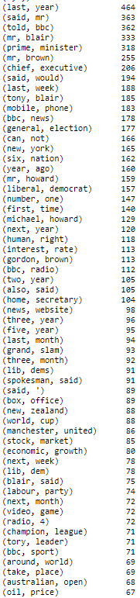
N-gram
Notes:
Here are some of the words that often showed co-occurence in the dataset

Slide 10
Sample News Article and Summary
Sample News Article
Sample Summary
b'Ad sales boost Time Warner profit\n\nQuarterly profits at US media giant TimeWarner jumped 76% to $1.13bn (\xc2\xa3600m) for the three months to December, from $639m year-earlier.\n\nThe firm, which is now one of the biggest investors in Google, benefited from sales of high-speed internet connections and higher advert sales. TimeWarner said fourth quarter sales rose 2% to $11.1bn from $10.9bn. Its profits were buoyed by one-off gains which offset a profit dip at Warner Bros, and less users for AOL.\n\nTime Warner said on Friday that it now owns 8% of search-engine Google. But its own internet business, AOL, had has mixed fortunes. It lost 464,000 subscribers in the fourth quarter profits were lower than in the preceding three quarters. However, the company said AOL\'s underlying profit before exceptional items rose 8% on the back of stronger internet advertising revenues. It hopes to increase subscribers by offering the online service free to TimeWarner internet customers and will try to sign up AOL\'s existing customers for high-speed broadband. TimeWarner also has to restate 2000 and 2003 results following a probe by the US Securities Exchange Commission (SEC), which is close to concluding…..
b"TimeWarner said fourth quarter sales rose 2% to $11.1bn from $10.9bn.For the full-year, TimeWarner posted a profit of $3.36bn, up 27% from its 2003 performance, while revenues grew 6.4% to $42.09bn.Quarterly profits at US media giant TimeWarner jumped 76% to $1.13bn (\xc2\xa3600m) for the three months to December, from $639m year-earlier.However, the company said AOL's underlying profit before exceptional items rose 8% on the back of stronger internet advertising revenues.Its profits were buoyed by one-off gains which offset a profit dip at Warner Bros, and less users for AOL.For 2005, TimeWarner is projecting operating earnings growth of around 5%, and also expects higher revenue and wider profit margins.It lost 464,000 subscribers in the fourth quarter profits were lower than in the preceding three quarters.Time Warner's fourth quarter profits were slightly better than analysts' expectations."
Notes:
With more time, we might be able to look through the dataset more carefully...

Slide 11
3. Data preprocessing

Slide 12
Data Cleaning
Remove '\n', '\BA', parenthesis, multiple spaces, artifacts (e.g. '\'), various 'xa-' and 'xc2' that has not much meaningful insights
Substituted '$' with USD as dollar signs here in BBC news refers to US Dollars
Substituted '%' with 'percent'
Remove stopwords
Notes:
As seen in the sample earlier, we removed the meaningless artifacts and strings of x-- and substituted the “$” with USD as it referred to US dollars, but are special characters. The % is also substituted with the word “percent”. We also removed stopwords.

Slide 13
4. Modelling

Slide 14
2 types of text summarisation
Extractive | Abstractive
Extracts words/phrases/sentences from the original text to create a summary Selected sentences most relevant to the meaning of the source Like a highlighter | Paraphrases the provided text Learns an internal language representation to generate more human-like summaries Like a pen
Sample text:
Natural language processing (NLP) is a subfield of linguistics, computer science, and artificial intelligence concerned with the interactions between computers and human language, in particular how to program computers to process and analyze large amounts of natural language data. The result is a computer capable of understanding the contents of documents, including the contextual nuances of the language within them. The technology can then accurately extract information and insights contained in the documents as well as categorize and organize the documents themselves. Challenges in natural language processing frequently involve speech recognition, natural language understanding, and natural-language generation.

Slide 15
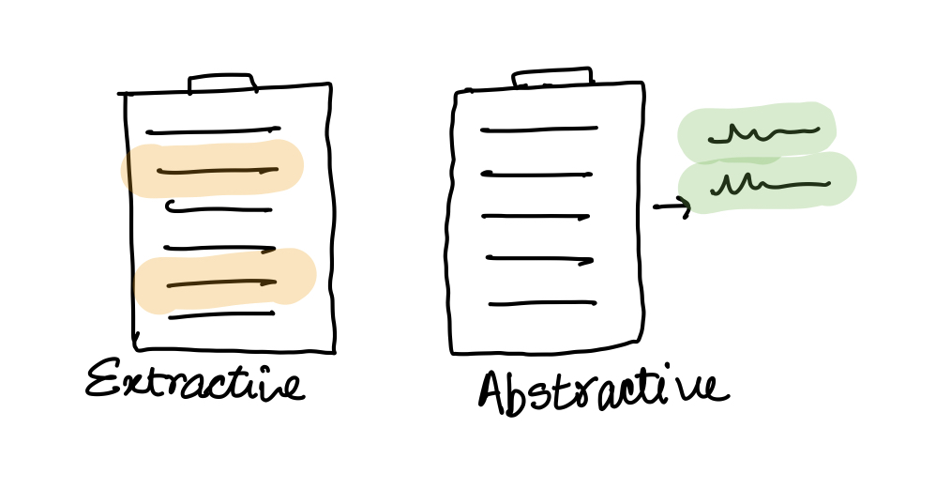
Examples of both in action
Method | Output Summary
Extractive | Challenges in natural language processing frequently involve speech recognition, natural language understanding, and natural-language generation. The result is a computer capable of understanding the contents of documents, including the contextual nuances of the language within them. The technology can then accurately extract information and insights contained in the documents as well as categorize and organize the documents themselves.
Abstractive | Natural language processing (NLP) is a subfield of linguistics, computer science, and artificial intelligence concerned with the interactions between computers and human language. A computer capable of understanding the contents of documents can extract information and insights contained in them, categorize and organize the documents themselves.

Slide 16
Models used
Model | Details | Pros | Cons
NLTK Model (Extractive) | Each word has a weighted score Sentences are ranked based on these scores Top X sentences will be used in the output (X can be adjusted) | Simple implementation | Lack of coherence at times
BERT (Extractive) | A pre-trained BERT summarizer model that was trained on scientific text (SciBERT) The training corpus was papers taken from Semantic Scholar. Corpus size is 1.14M papers, 3.1B tokens | More accurate in retrieving key points of the summary | Large dataset needed to retrain output layers for specific domain
KL-Sum (Extractive) | Selects sentences based on similarity of a sentence's word distribution against the full text Greedy algo; seeks to minimise the KL (Kullback–Leibler) divergence | Closer representation of distribution against the input text | Still not as good as abstractive summary
T5 (Abstractive) | Pretrained on C4 (Colossal Clean Crawled Corpus), 700GB T5 base model with LM on top, fine-tuned on a news summary dataset | Coherent and paraphrased summaries | Longer to summarize

Slide 17
5. Evaluation

Slide 18
Metrics used
Bertscore | ROUGE
The output summary is evaluated against the original text, using contextual embeddings for the tokens. Cosine similarity is then used to compute the matching, optionally weighted with idf. | Looks at how many n-grams in the reference summary shows up in the output summary 3 variations: Rouge-1: unigrams Rouge-2: bigrams Rouge-L: longest subsequence
Notes:
Warning: Evaluation Metrics
For summarization, automatic metrics such as ROUGE and METEOR have serious limitations:
They only assess content selection and do not account for other quality aspects, such as fluency, grammaticality, coherence, etc.
To assess content selection, they rely mostly on lexical overlap, although an abstractive summary could express they same content as a reference without any lexical overlap.
Given the subjectiveness of summarization and the correspondingly low agreement between annotators, the metrics were designed to be used with multiple reference summaries per input. However, recent datasets such as CNN/DailyMail and Gigaword provide only a single reference.
Therefore, tracking progress and claiming state-of-the-art based only on these metrics is questionable. Most papers carry out additional manual comparisons of alternative summaries. Unfortunately, such experiments are difficult to compare across papers.

Slide 19
Bertscore
Metric | NLTK Model | BERT Model | KL-Sum Model | T5 Transformer Model
Precision | 0.93 | 0.96 | 0.93 | 0.93
Recall | 0.86 | 0.86 | 0.87 | 0.83
F1 | 0.89 | 0.91 | 0.90 | 0.88

Slide 20
ROUGE-2 (Bigrams)
Metric | NLTK Model | BERT Model | KL-Sum Model | T5 Transformer Model
Precision | 0.46 | 0.45 | 0.44 | 0.38
Recall | 0.39 | 0.28 | 0.30 | 0.19
F1 | 0.41 | 0.34 | 0.34 | 0.24

Slide 21
ROUGE-L (Longest subsequence)
Metric | NLTK Model | BERT Model | KL-Sum Model | T5 Transformer Model
Precision | 0.55 | 0.57 | 0.57 | 0.57
Recall | 0.51 | 0.41 | 0.41 | 0.34
F1 | 0.52 | 0.47 | 0.46 | 0.42
Notes:
Based on outputs, suspect that NLTK was used for the reference summary which is why the rouge score is marginally higher

Slide 22
KL-Sum model chosen for implementation
Results from models are all comparable
T5 transformer has lower ROUGE scores, possibly due to a max token length of 512
Time consideration
Model | Para of 400 words | Top ten news articles
NLTK Model | < 1s | < 20s
BERT | < 12s | < 120s
KL-Sum | < 1s | < 20s
T5 | 2 mins | > 20 mins
Notes:
Based on outputs, suspect that NLTK was used for the reference summary which is why the rouge score is marginally higher
No one way to determine the “best” model; still need some human review

Slide 23
6. Deployment

Slide 24


API used
Host web from Flask Application
Free template from https://startbootstrap.com/
Using Inference and Predict functions like last assignment to get output from model

Slide 25
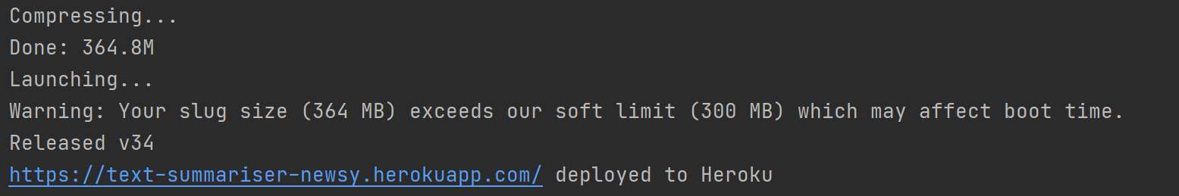
Heroku max size of 500 mb
When deploying to Heroku, for the free tier:
any size more than 300mb will have performance issues
max size of 500 mb
Machine learning models will exceed capacity if it has torch as dependency.
If not specified in requirements.txt and your model requires the use of torch, it will auto download latest compatible version which is around 776.8 mb.
Solution: Torch-CPU only (around 130 mb)
###### Specify torch cpu ######
torch==1.5.0+cpu
torchvision==0.6.0+cpu
-f https://download.pytorch.org/whl/torch_stable.html

Slide 26

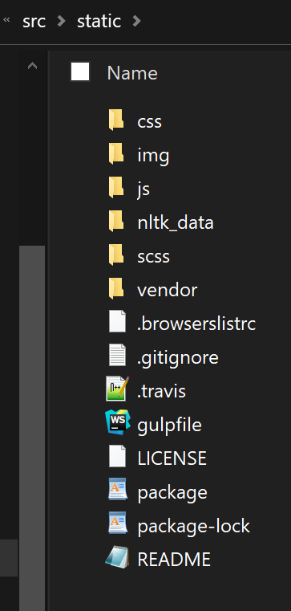
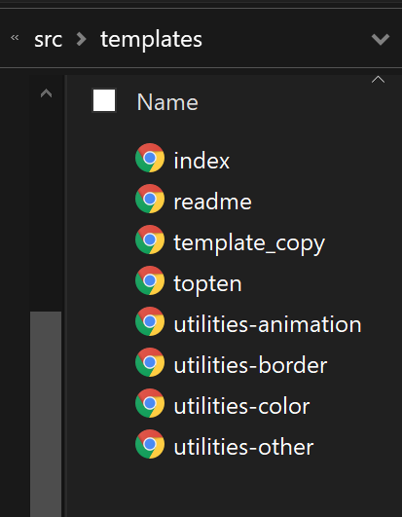
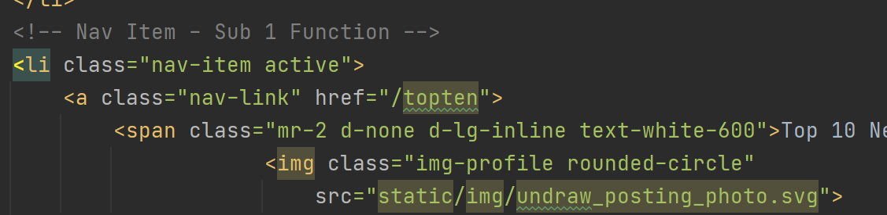
Bootstrap
Free Front-end framework for faster and easier web development
Everybody can create their front end web application with a few simple steps:
1. Find your free HTML/CSS templates https://startbootstrap.com/
2. Manually edit the HTML/CSS files that you downloaded
Unzip package
Sort HTML files into 2 Sub folders, static, templates(HTML)
Specify the right filepath in your app.py
In the HTML file, edit filepath of any src/href
*Or use a bootstrap package that sorts it for you https://getbootstrap.com/

Slide 27
7. Demo

Slide 28
THANK YOU!

Slide 29
NLTK Model (extractive)
A simple NLTK extractive summarizer that is used as our baseline model for comparison against the better pretrained models
Uses weightage scores of each words to determine the scores of each sentence in the summary to generate a ranking for each sentence before output
Summary will be generated based on the scoring of each sentences and the number of sentences chosen can be adjusted
Example summary:
Challenges in natural language processing frequently involve speech recognition, natural language understanding, and natural-language generation. The result is a computer capable of understanding the contents of documents, including the contextual nuances of the language within them. The technology can then accurately extract information and insights contained in the documents as well as categorize and organize the documents themselves.

Slide 30
Models used
2. Bert Model (extractive):
- A pre-trained BERT summarizer model that was trained on SciBERT(BERT model trained on scientific text)
- The training corpus was papers taken from Semantic Scholar. Corpus size is 1.14M papers, 3.1B tokens. Full text of the papers in training (not just abstracts)
- Additional layers can be added and trained in the future to further improve the evaluation score
Example summary:
Natural language processing (NLP) is a subfield of linguistics, computer science, and artificial intelligence concerned with the interactions between computers and human language, in particular how to program computers to process and analyze large amounts of natural language data. The technology can then accurately extract information and insights contained in the documents as well as categorize and organize the documents themselves.

Slide 31
Models used
3. KL-Sum Model (extractive):
- selects sentences based on similarity of a sentence's word distribution against the full text
- greedy algo
- seeks to minimise the KL (Kullback–Leibler) divergence
Example summary:
The result is a computer capable of understanding the contents of documents, including the contextual nuances of the language within them. The technology can then accurately extract information and insights contained in the documents as well as categorize and organize the documents themselves. Challenges in natural language processing frequently involve speech recognition, natural language understanding, and natural-language generation.

Slide 32
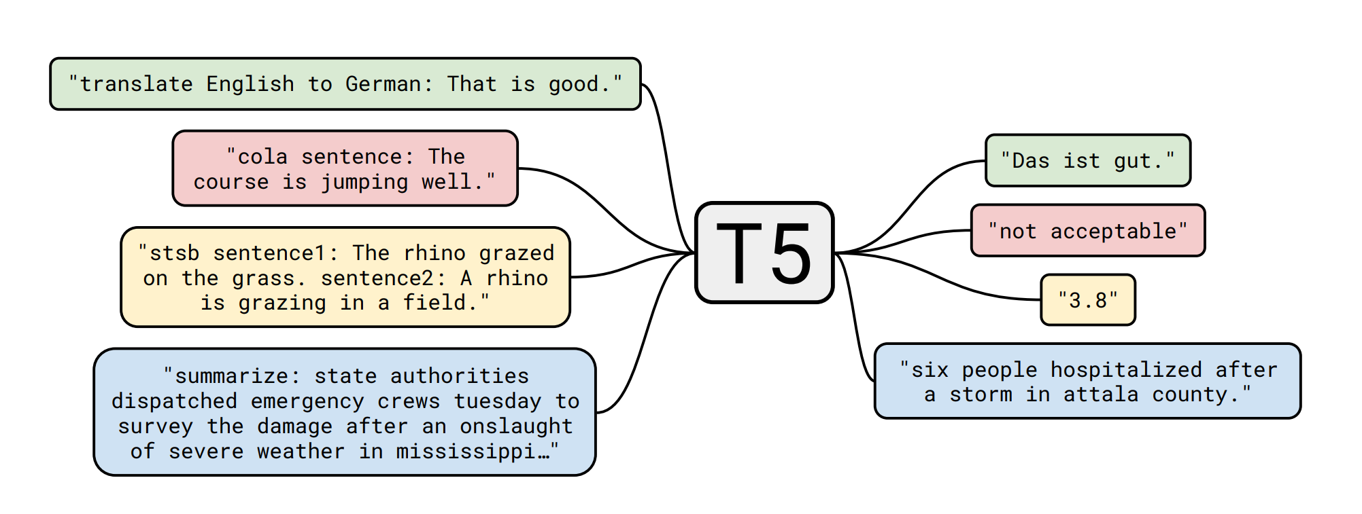
Models used
4. T5 Transformer Model (abstractive):
- pretrained on C4 (Colossal Clean Crawled Corpus), 700GB
- T5 base model with LM on top was used, fine-tuned on a news summary dataset
Example summary:
Natural language processing (NLP) is a subfield of linguistics, computer science, and artificial intelligence concerned with the interactions between computers and human language. A computer capable of understanding the contents of documents can extract information and insights contained in them, categorize and organize the documents themselves.

